Slide 1
An Integrated Phylogeographic Assessment of the Bantu Migration
Colby T. Ford

Slide 2

About Me
Awards:
2007 – 2011 Gates Foundation Grant
2012 – 2014 Coffey Scholar
2012 – 2014 C.L. Robbins Scholar
2015 – 2016 Wayland H. Cato Fellowship
Affiliations:
Society for Industrial and Applied Mathematics
American Statistical Association
Society for Anthropological Sciences
UNCC Data Science Initiative Advisory Board
Northeastern University LEVEL Advisory Board
Microsoft Preferred Partner
Data Science and Advanced Analytics
Bachelor of Arts
Applied Mathematics
Magna Cum Laude
Master of Science
Data Science and Business Analytics
First Graduate
Doctor of Philosophy (Current Program)
Bioinformatics and Computational Biology

Slide 3




Presentation Outline
Introduction and Background
Migratory Model Generation
Dimensionality Reduction and Machine Learning
Conclusion and Future Work

Slide 4
Introduction and Background
Notes:
DARPA - Integrating linguistic, ethnographic, and genetic information of human populations (w/ AMNH).

Slide 5
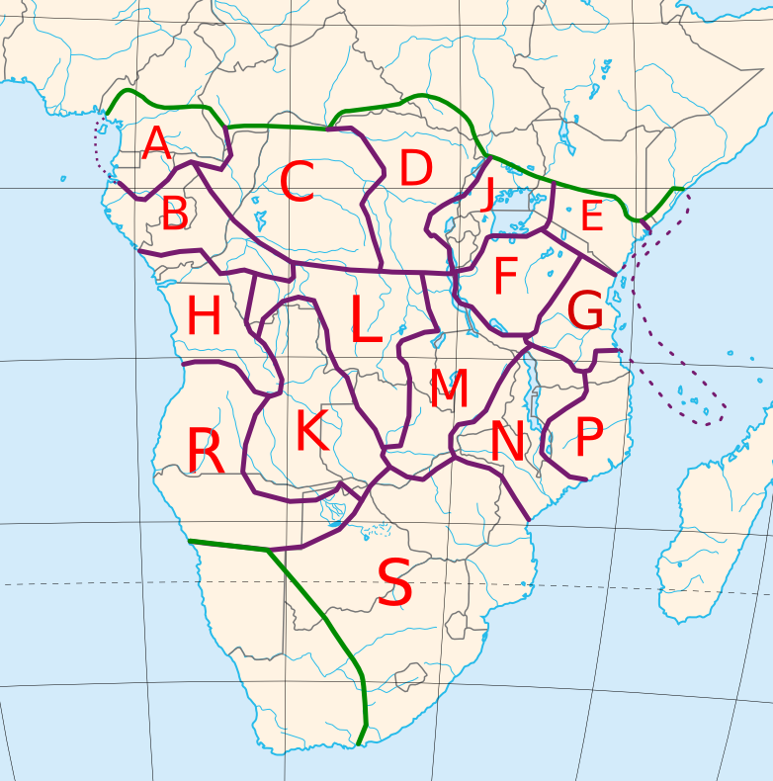
Introduction and Background
Bantu:
A group of more than 200 million people that migrated throughout the continent of Africa ~3,000 years ago
Accounts for ~1/3 of the population on the continent
Covers the area from southern Cameroon to most of South Africa
Consists of about 600 languages (including dialects)
Guthrie Zones:
Cultural boundaries defined by Malcom Guthrie (1948, 1967-1971)
First expansion models in the late 1960s by Roland Oliver
Hierarchy (Maho, 2009):
16 Zones
83 Decades (Groups)
682 Units (Language and Dialect Clusters)
Example: A32a Banoo
(Edricson, 2007)
Notes:
Influential in spreading culture, language, and (of course) genetic traits.
Bantu lead a more sedentary lifestyle compared to the indigenous people
Farming versus forest foraging (using the land’s resources)
Developments: agriculture, ceramics, and the use of iron
Guthrie zones: 16 (+1 for outgroup)
Roland’s work – Archeological, linguistic, and geographic data

Slide 6
Differing Migration Models | The Problem
Consensus that the group started in present-day Cameroon
After that, there is a considerable amount of disagreement for the expansion trajectory
Researchers from various disciplines have published their findings of the Bantu migration, but all used different data sets
These papers show very different migratory paths
“Early Split” vs. “Late Split”

Slide 7
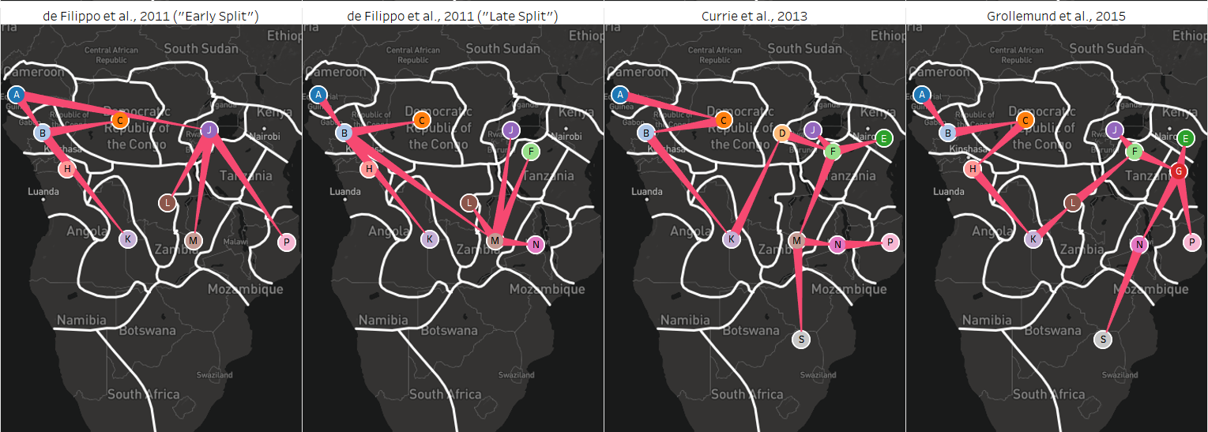
(a)
(b)
(c)
(d)
By: de Filippo et al., 2011
Cesare de Filippo – Max Planck Institute for Evolutionary Anthropology, Dept. of Evolutionary Genetics
Data: Autosomal STR loci, Lexical
Split the data into 6 super groups such as Pygmy, Afro-Asiatic, Niger-Congo, etc.
Analyzed correlations and distances between genetic and lexical data
By: Currie et al., 2013
Thomas E. Currie– U. of Exeter, Cultural Evolution and Anthropology
Data: Lexical
By: Grollemund et al., 2015
Rebecca Grollemund– U. of Missouri, Depts. of Anthropology and English
Data: Lexical
Notes:
Currie’s Abstract – “There is disagreement about the routes taken by populations speaking Bantu languages as they expanded to cover much of sub-Saharan Africa.”
“Bantu 542”

Slide 8
Differing Migration Models | Hypothesis
The de Filippo models show two different points of divergence:
Early split beginning in present-day Cameroon
Later split below the Congolese rainforest region, following a more linear migration path.
By combining the cultural and genomic data to create a single migratory path, this hypothesis was tested.
"Bantu expansion can be characterized by a primary split in lineages, which occurred early on and prior to the population spreading south through the now Congolese forest region."
Notes:
The technical hypothesis is that, by using more data (and combining it), the resulting migratory model is more robust than individual singularly-faceted models.
“By combining diverse data together, a more robust migratory model can be generated that captures more of the complexity/variation in the Bantu people.”
"A better reconstruction"

Slide 9
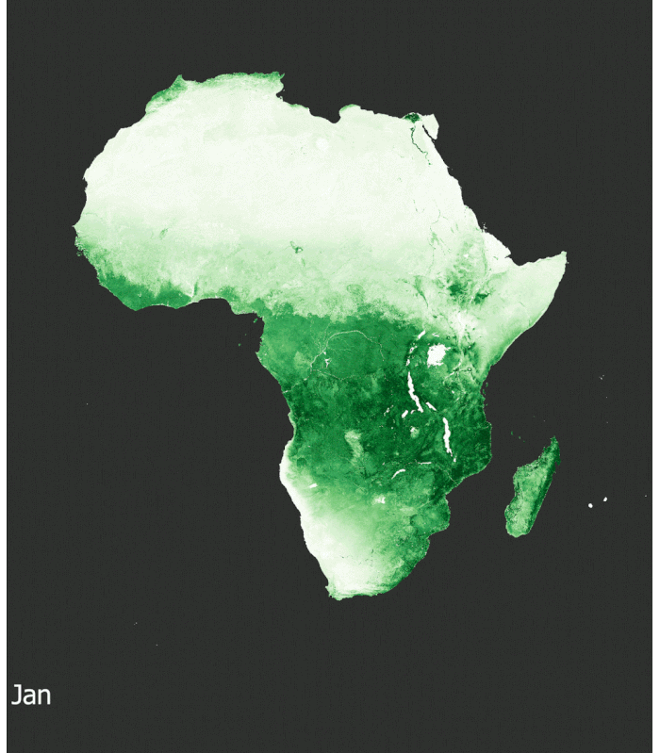
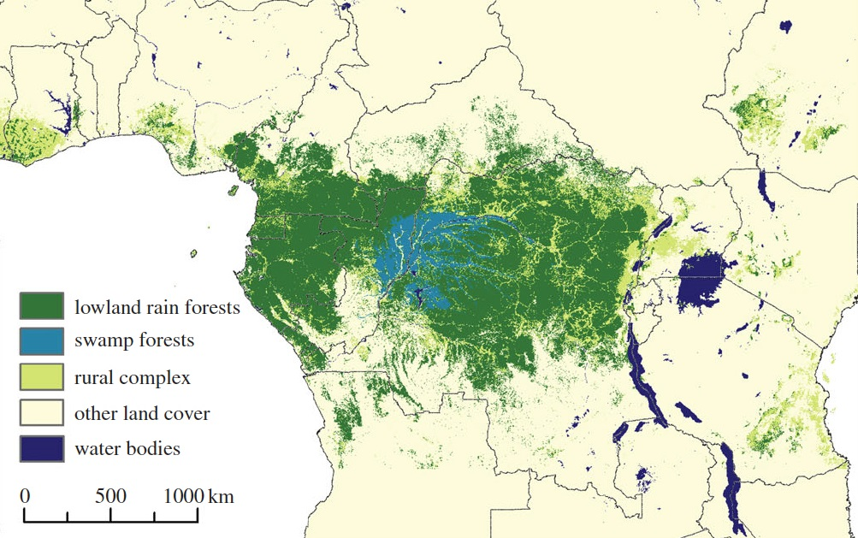
The Congolese Forest | Geographic Barrier
Yearly Vegetation Changes - NDVI values as a Time Series
Created by mikea0228, 2018. [Link]
A sub-hypothesis around the migratory path is that the Congolese forest has provided a geographic boundary of sorts, around which the Bantu peoples migrated
Runs through southern Cameroon, Gabon, Republic of Congo, and the Democratic Republic of Congo
(Mayaux et al., 2013)

Slide 10
The Congolese Forest | Geographic Barrier
A sub-hypothesis around the migratory path is that the Congolese forest has provided a geographic boundary of sorts, around which the Bantu peoples migrated
Runs through southern Cameroon, Gabon, Republic of Congo, and the Democratic Republic of Congo
(Mayaux et al., 2013)

Slide 11
Migratory Model Generation

Slide 12
Bantu Migration | Materials and Methods
Data Sources and Organization
Alignment and Phylogeny Creation
18 Data Sources:
8 mtDNA
57 Bantu Groups + 2 outgroups
9 Y-chromosomal
49 Bantu Groups + 2 outgroups
1 Cultural
91 Bantu Groups + 12 outgroups
Multiple Sequence Alignment:
MAFFT (Katoh, 2002)
Tree Generation:
POY5 (Wheeler et al., 2013)
PAUP* (Swofford, 2008)
Curation of mtDNA and Ychr data was performed by Dr. Jia Wen and Conor Nodzak
Notes:
All data were curated from other publications on the topic.
Curation efforts from Jia and Conor
POY5 for generating trees, PAUP for extracting the apomorphies in the generated trees.

Slide 13
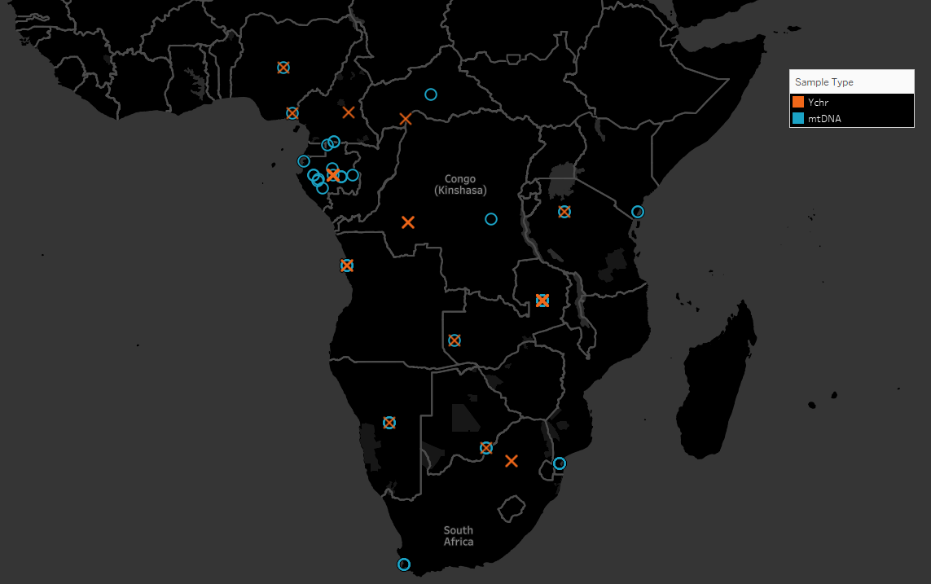
Bantu Migration | Data Samples
Guthrie zone | mtDNA | Ychr | Cultural | Total
A | 5 | 155 | 5 | 165
B | 10 | 569 | 5 | 584
C | 4 | 215 | 11 | 230
D |  |  | 5 | 5
E | 2 |  | 6 | 8
F |  | 30 | 3 | 33
G | 2 |  | 7 | 9
H | 21 | 49 | 6 | 76
J |  |  | 9 | 9
K | 184 | 165 | 3 | 352
L | 42 | 36 | 2 | 80
M | 104 | 118 | 6 | 228
N | 8 | 7 | 6 | 21
P |  |  | 2 | 2
R | 148 | 173 | 3 | 324
S | 212 | 207 | 12 | 431
Z (Outgroup) | 4 | 157 | 12 | 173
Total | 746 | 1881 | 103 | 2730
Zone Coverage | 75% | 69% | 100% | 100%
Notes:
Note that multiple samples may be taken from a single point

Slide 14
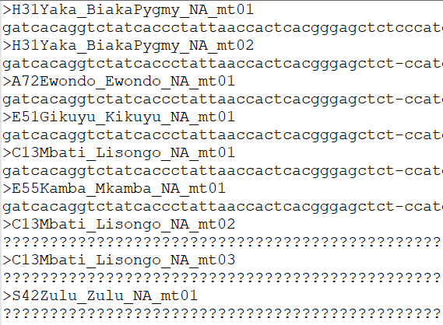
Bantu Migration | mtDNA Data
Mitochondrial DNA Samples
746 Samples
Length: 16,591 aligned nucleotides
Outgroups: Efik and Yoruba
Aligned using MAFFT (Katoh, 2002)
Notes:
MATERNAL
Outgroups: Nigerian Languages (Yoruba, Efik, etc.)

Slide 15
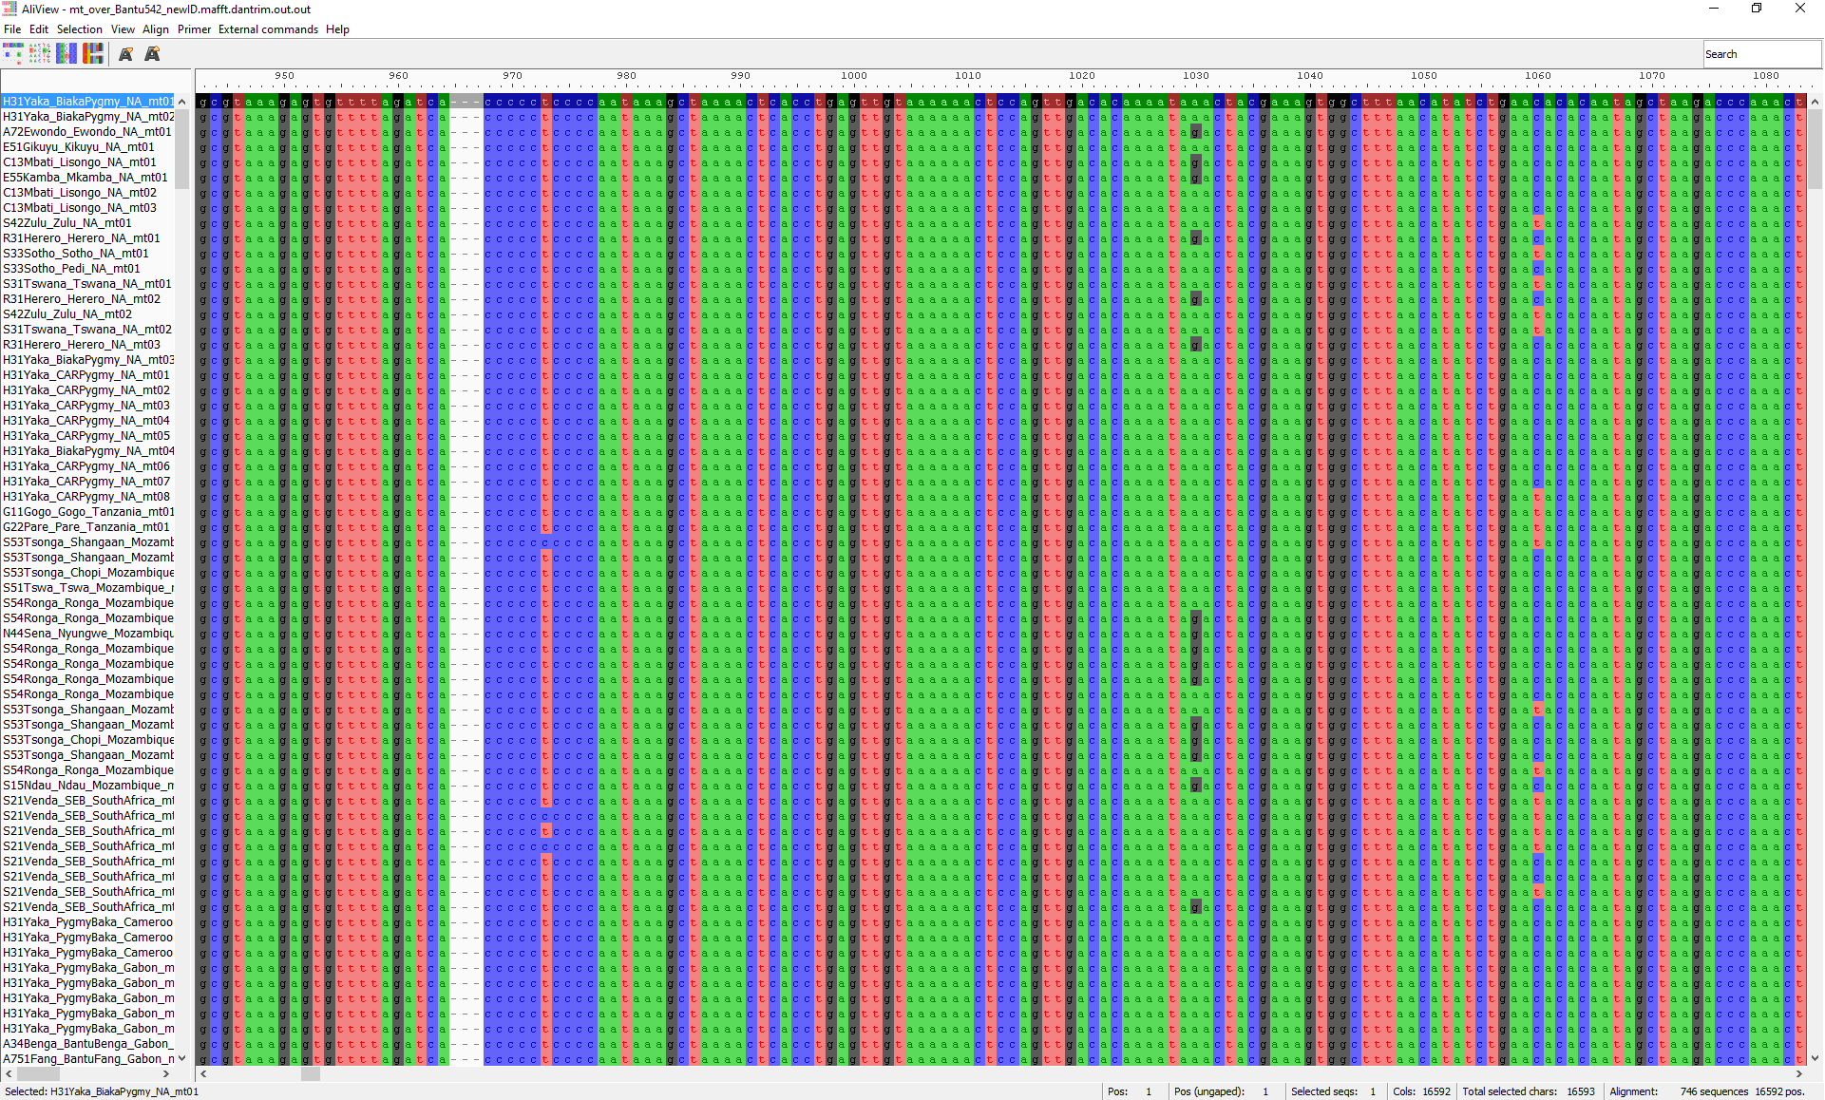
Multiple Sequence Alignment | mtDNA Data
Multiple Sequence Alignment Performed in MAFFT
Default Settings
--thread 20
Very few indels
Curated a few sequence read errors
Notes:
Multiple Alignment using Fast Fourier Transforms
-Took out D characters, which are one of G, A, or T.
DEFAULT OPTIONS
Algorithm
--auto
Automatically selects an appropriate strategy from L-INS-i, FFT-NS-i and FFT-NS-2, according to data size. Default: off (always FFT-NS-2)
--6merpair
Distance is calculated based on the number of shared 6mers. Default: on
--globalpair
All pairwise alignments are computed with the Needleman-Wunsch algorithm. More accurate but slower than --6merpair. Suitable for a set of globally alignable sequences. Applicable to up to ~200 sequences. A combination with --maxiterate 1000 is recommended (G-INS-i). Default: off (6mer distance is used)
--localpair
All pairwise alignments are computed with the Smith-Waterman algorithm. More accurate but slower than --6merpair. Suitable for a set of locally alignable sequences. Applicable to up to ~200 sequences. A combination with --maxiterate 1000 is recommended (L-INS-i). Default: off (6mer distance is used)
--genafpair
All pairwise alignments are computed with a local algorithm with the generalized affine gap cost (Altschul 1998). More accurate but slower than --6merpair. Suitable when large internal gaps are expected. Applicable to up to ~200 sequences. A combination with --maxiterate 1000 is recommended (E-INS-i). Default: off (6mer distance is used)
--fastapair
All pairwise alignments are computed with FASTA (Pearson and Lipman 1988). FASTA is required. Default: off (6mer distance is used)
--weighti number
Weighting factor for the consistency term calculated from pairwise alignments. Valid when either of --globalpair, --localpair, --genafpair, --fastapair or --blastpair is selected. Default: 2.7
--retree number
Guide tree is built number times in the progressive stage. Valid with 6mer distance. Default: 2
--maxiterate number
number cycles of iterative refinement are performed. Default: 0
--fft
Use FFT approximation in group-to-group alignment. Default: on
--nofft
Do not use FFT approximation in group-to-group alignment. Default: off
--noscore
Alignment score is not checked in the iterative refinement stage. Default: off (score is checked)
--memsave
Use the Myers-Miller (1988) algorithm. Default: automatically turned on when the alignment length exceeds 10,000 (aa/nt).
--parttree
Use a fast tree-building method (PartTree, Katoh and Toh 2007) with the 6mer distance. Recommended for a large number (> ~10,000) of sequences are input. Default: off
--dpparttree
The PartTree algorithm is used with distances based on DP. Slightly more accurate and slower than --parttree. Recommended for a large number (> ~10,000) of sequences are input. Default: off
--fastaparttree
The PartTree algorithm is used with distances based on FASTA. Slightly more accurate and slower than --parttree. Recommended for a large number (> ~10,000) of sequences are input. FASTA is required. Default: off
--partsize number
The number of partitions in the PartTree algorithm. Default: 50
--groupsize number
Do not make alignment larger than number sequences. Valid only with the --*parttree options. Default: the number of input sequences
Parameter
--op number
Gap opening penalty at group-to-group alignment. Default: 1.53
--ep number
Offset value, which works like gap extension penalty, for group-to-group alignment. Default: 0.123
--lop number
Gap opening penalty at local pairwise alignment. Valid when the --localpair or --genafpair option is selected. Default: -2.00
--lep number
Offset value at local pairwise alignment. Valid when the --localpair or --genafpair option is selected. Default: 0.1
--lexp number
Gap extension penalty at local pairwise alignment. Valid when the --localpair or --genafpair option is selected. Default: -0.1
--LOP number
Gap opening penalty to skip the alignment. Valid when the --genafpair option is selected. Default: -6.00
--LEXP number
Gap extension penalty to skip the alignment. Valid when the --genafpair option is selected. Default: 0.00
--bl number
BLOSUM number matrix (Henikoff and Henikoff 1992) is used. number=30, 45, 62 or 80. Default: 62
--jtt number
JTT PAM number (Jones et al. 1992) matrix is used. number>0. Default: BLOSUM62
--tm number
Transmembrane PAM number (Jones et al. 1994) matrix is used. number>0. Default: BLOSUM62
--aamatrix matrixfile
Use a user-defined AA scoring matrix. The format of matrixfile is the same to that of BLAST. Ignored when nucleotide sequences are input. Default: BLOSUM62
--fmodel
Incorporate the AA/nuc composition information into the scoring matrix. Default: off

Slide 16
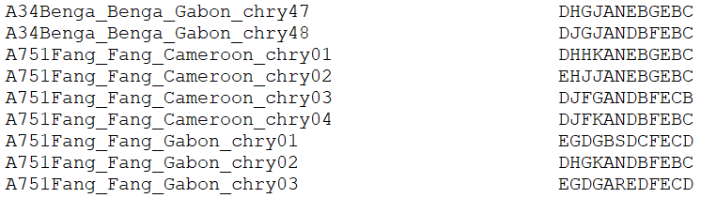
Bantu Migration | Ychr Data
Y-Chromosomal Samples
1,881 Samples
Length: 12 Short Tandem Repeats (STRs)
Outgroups: Efik and Yoruba
Ychr Dataset Position | Marker Name | Allele Range | Repeat Motif(s) | GenBank Accession | Reference Allele
1 | DYS389_I | 9-17 | TCTG, TCTA, TCTG, TCTA | AC004617 | 12
2 | DYS389_II | 24-34 | TCTG, TCTA, TCTG, TCTA | AC004617 | 29
3 | DYS385a | 10-19 | GAAA | AC022486 | 11
4 | DYS385b | 10-19 | GAAA | AC022486 | 11
5 | DYS391 | 6-14 | TCTA | AC011302 | 11
6 | DYS390 | 17-28 | TCTA, TCTG | AC011289 | 24
7 | DYS393 | 9-17 | AGAT | AC006152 | 12
8 | DYS392 | 6-17 | TAT | AC011745 | 13
9 | DYS19 | 10-19 | TAGA | AC017019 | 15
10 | DYS437 | 13-17 | TCTA | AC002992 | 16
11 | DYS438 | 6-14 | TTTTC | AC002531 | 10
12 | DYS439 | 9-14 | AGAT | AC002992 | 13
Adapted from Buter et al., 2008
Notes:
PATERNAL
STR info:
Microsatellite of nucleotides that are repeated tens to hundreds of times.
Used to compare specific loci of DNA on 2 or more samples.
“fingerprint” popular in population genetics and even forensics.
Outgroups: Nigerian Languages (Yoruba, Efik, etc.)

Slide 17
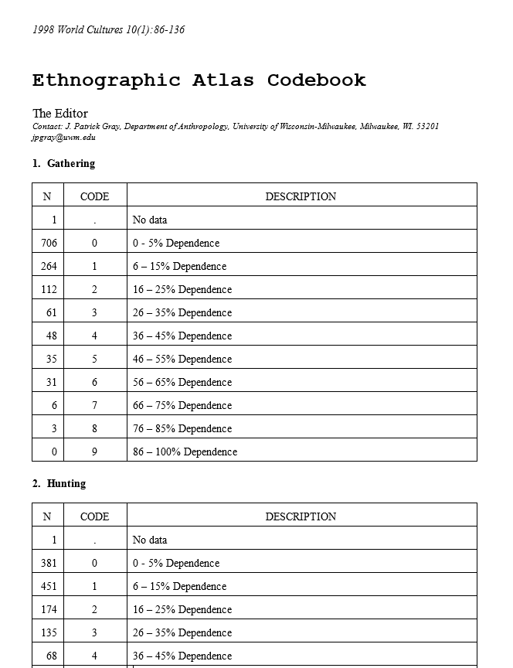
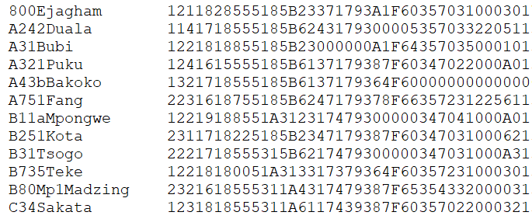
Bantu Migration | Cultural Data
Cultural Samples
103 Samples
Length: 92 Cultural Traits
Outgroups: Ekoi languages
Notes:
Cultural info:
From the Cultural Ethnographic Atlas
Dependence on hunting, gathering, fishing, mode of marriage and allowed kin (can you marry your cousin), genital mutilations, gender roles, etc.
Outgroups: Ekoi Languages (Bangang, Ghomala, Fefe, Ejagham, etc.)

Slide 18












Bantu Migration | Tree Generation Pipeline
Input Data
Tree Generation
Model Output
Y-chromosomal STR
POY5
PAUP
.nexus
.tree
Mitochondrial DNA
MAFFT
POY5
PAUP
.fasta
.afa
.tree
Cultural
POY5
PAUP
.nexus
.tree
Combined
POY5
PAUP
MAFFT | (Katoh, 2002)
PAUP | (Swofford, 2008)
POY | (Wheeler et al., 2013)
.nexus
.tree

Slide 19
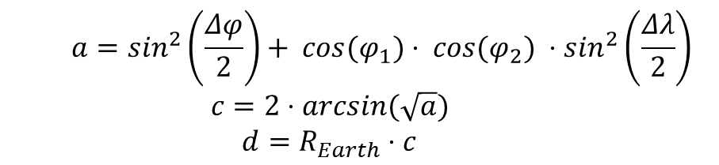
Bantu Migration | Haversine Distance
“As the crow flies…”
Haversine Distance vs. Euclidean
The Haversine Formula
Using the latitude and longitude coordinates between two points, the distance between then can be calculated.
Given that the points are on the surface of a sphere (the Earth), the geometry is a little different.
Using the Euclidean distance (the flat, straight distance) between two distant points on a sphere would ignore the curvature of the surface.
Haversine distance is more accurate, especially at the continental-scale.
Latitudes
Longitudes
$$a=\sin^{2}\left(\frac{Δφ}{2}\right)+ cos⁡(φ_{1})⋅ cos⁡(φ_{2}) ⋅\sin^{2}\left(\frac{Δλ}{2}\right)$$
$$c=2⋅arcsin⁡(\sqrt{a})$$
$$d=R_{Earth}⋅c$$
d
(van Brummelen, 2013)

Slide 20
Bantu Migration | Sankoff Matrix
Zone | A | B | C | D | E | F | G | H | J | K | L | M | N | P | R | S | Z
A | 0 | 555 | 1269 | 1977 | 3171 | 2611 | 3176 | 1068 | 2329 | 2151 | 2198 | 2702 | 3111 | 3624 | 2098 | 3524 | 395
B | 555 | 0 | 928 | 1606 | 2812 | 2215 | 2762 | 513 | 1974 | 1597 | 1685 | 2171 | 2596 | 3133 | 1585 | 2970 | 936
C | 1269 | 928 | 0 | 708 | 1909 | 1342 | 1910 | 850 | 1065 | 1399 | 1122 | 1655 | 1980 | 2423 | 1834 | 2680 | 1499
D | 1977 | 1606 | 708 | 0 | 1207 | 637 | 1209 | 1381 | 370 | 1377 | 831 | 1273 | 1462 | 1802 | 2053 | 2384 | 2191
E | 3171 | 2812 | 1909 | 1207 | 0 | 624 | 398 | 2543 | 844 | 2140 | 1529 | 1572 | 1359 | 1220 | 2931 | 2497 | 3352
F | 2611 | 2215 | 1342 | 637 | 624 | 0 | 573 | 1923 | 344 | 1567 | 943 | 1125 | 1094 | 1259 | 2343 | 2186 | 2827
G | 3176 | 2762 | 1910 | 1209 | 398 | 573 | 0 | 2430 | 900 | 1873 | 1296 | 1235 | 973 | 843 | 2669 | 2106 | 3400
H | 1068 | 513 | 849 | 1381 | 2543 | 1923 | 2430 | 0 | 1744 | 1086 | 1244 | 1696 | 2139 | 2702 | 1141 | 2457 | 1446
J | 2329 | 1974 | 1065 | 370 | 844 | 344 | 900 | 1744 | 0 | 1599 | 990 | 1312 | 1377 | 1599 | 2330 | 2415 | 2521
K | 2151 | 1597 | 1399 | 1377 | 2140 | 1567 | 1873 | 1086 | 1599 | 0 | 645 | 755 | 1224 | 1830 | 796 | 1376 | 2521
L | 2198 | 1685 | 1122 | 831 | 1529 | 923 | 1296 | 1244 | 990 | 625 | 0 | 533 | 913 | 1458 | 1404 | 1590 | 2516
M | 2702 | 2171 | 1655 | 1273 | 1572 | 1125 | 1235 | 1696 | 1312 | 755 | 533 | 0 | 470 | 1075 | 1510 | 1113 | 3034
N | 3111 | 2596 | 1980 | 1462 | 1359 | 1094 | 973 | 2139 | 1377 | 1224 | 913 | 470 | 0 | 608 | 1959 | 1139 | 3423
P | 3624 | 3133 | 2423 | 1802 | 1220 | 1259 | 843 | 2702 | 1599 | 1830 | 1458 | 1075 | 608 | 0 | 2562 | 1479 | 3909
R | 2098 | 1585 | 1834 | 2053 | 2931 | 2343 | 2669 | 1141 | 2330 | 796 | 1404 | 1510 | 1959 | 2562 | 0 | 1695 | 2493
S | 3524 | 2970 | 2680 | 2384 | 2497 | 2186 | 2106 | 2457 | 2415 | 1376 | 1590 | 1113 | 1139 | 1479 | 1695 | 0 | 3896
Z | 395 | 936 | 1499 | 2191 | 3352 | 2827 | 3400 | 1446 | 2521 | 2521 | 2516 | 3034 | 3423 | 3909 | 2493 | 3896 | 0
Using the Haversine formula, the distance is calculated between the centroids of each Guthrie zone.
This is converted into a symmetric matrix for use as the Sankoff matrix in the phylogenetic analyses.

Slide 21
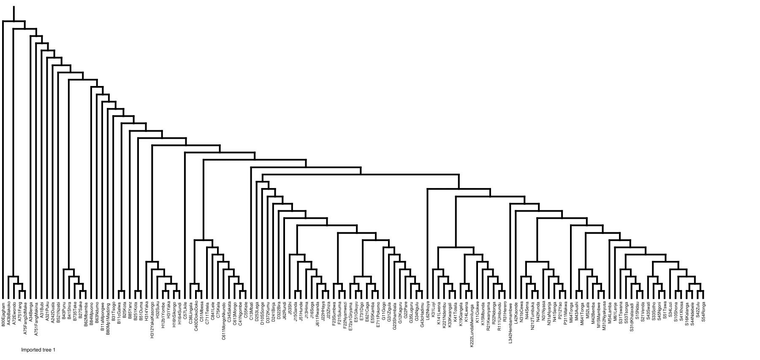
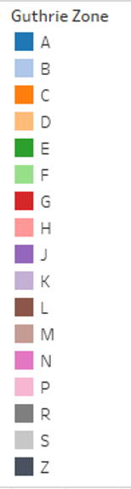
Individual Tree: mtDNA Data
Notes:
Movements from zones B to C and [a split from E to F and E to G]
Monophyletic: H, F, E, G, R, P and S.

Slide 22
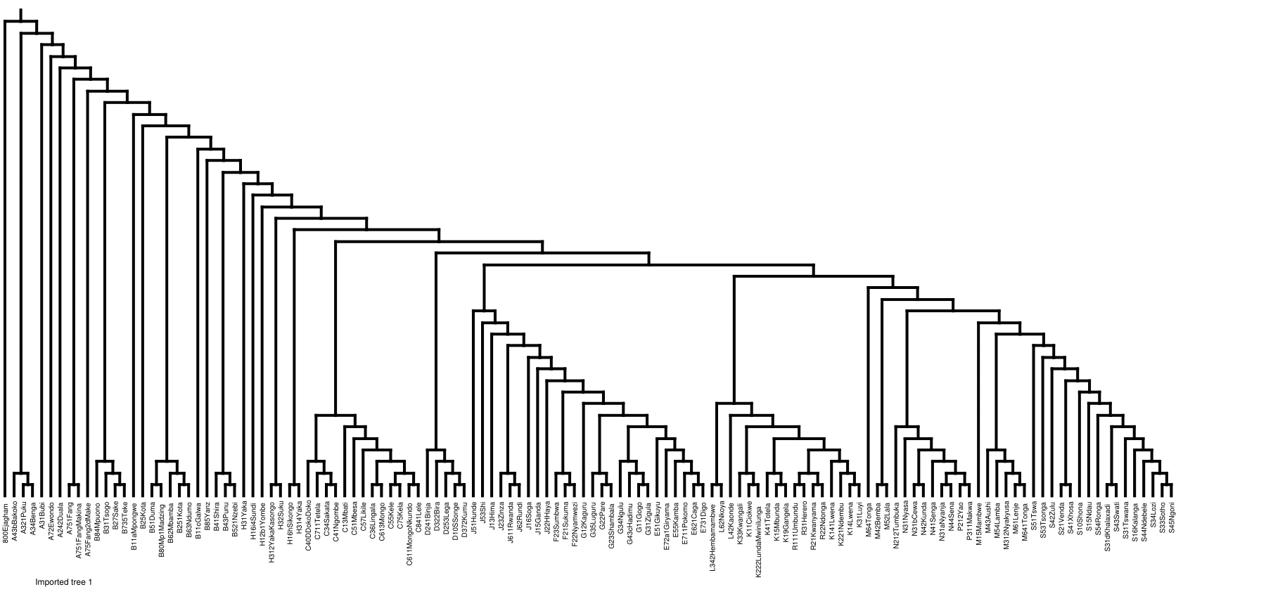
Individual Tree: Ychr Data
Notes:
Main split is at J. Then, M to L rather than L to M.]
Monophyletic: C, D, F, E, R, P, and S.

Slide 23
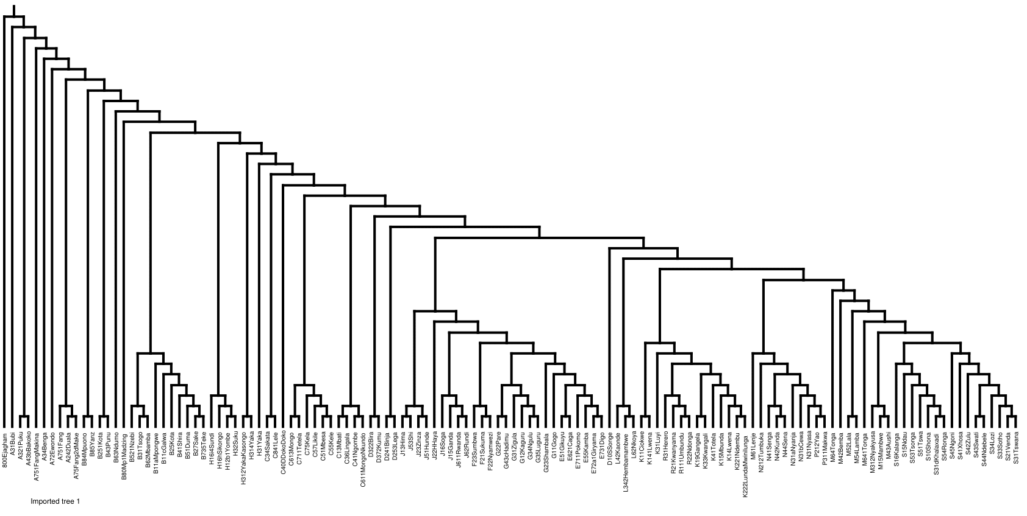
Individual Tree: Cultural Data
Notes:
D to K to L and K to M
Monophyletic: F, L, P, R, and S.

Slide 24
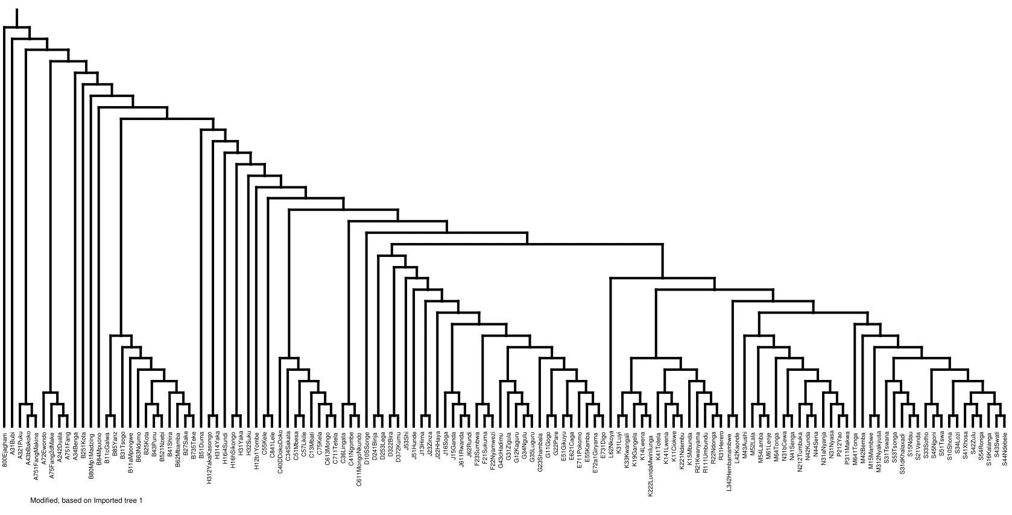
Combined Tree: mtDNA + Ychr + Cultural Data
Notes:
Monophyletic: S, P, F, and R

Slide 25
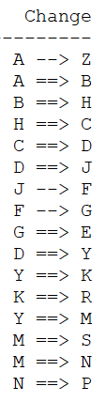
Bantu Migration | Apomorphy
Character Transitions as a Migratory Path
Apomorphy – a derived/specialized character unique to the group on the phylogenetic tree. Used to describe ancestor-descendent change in a character.
Guthrie zones are used as characters, which allow for the migratory path to be derived by tracking the character transitions in the tree(s).
With PAUP, the apomorphy list was generated using the POY tree as an input.
This apomorphy list is then converted into a data table, which is used for mapping.
Path ID | Point Order | Apomorphy Type | Latitude | Longitude | Guthrie Zone
A-B | 1 | Unambiguous | 2.349 | 10.311 | A
A-B | 2 | Unambiguous | -1.753 | 13.153 | B
B-H | 1 | Unambiguous | -1.753 | 13.153 | B
B-H | 2 | Unambiguous | -5.571 | 15.750 | H
… | … | … | … | … | …
F-G | 1 | Ambiguous | -3.733 | 33.000 | F
F-G | 2 | Ambiguous | -5.850 | 31.713 | G
Hennig (1956, 1966)
Notes:
Found in the PAUP log.
paup> describetrees 1/ root=outgroup apolist=yes;

Slide 26
Dimensionality Reduction and Machine Learning

Slide 27
Bantu Migration | Tabular Data Preparation
Data Organization and Aggregation
Preparation of Geographic Data
Split Label for Guthrie Zone-Level Roll-up:
Cleanse and integrate geographic information
Latitude and Longitude values for each Guthrie Zone center
Configure shapefile to map cultural zones instead of political boundaries
This information was used to generate comparable migratory visualizations to previous publications.
C13Mbati_Lisongo_NA_mt01
C13Mbati_Lisongo_NA_mt02
C13Mbati_Lisongo_NA_mt03
C13Mbati
C
Ensure Taxa Name Cohesion
C13Mbati vs. C13_Mbati vs. C13 Mbati

Slide 28
Bantu Migration | Database Creation
Making the Tables
SQL Ease of Use
Using Microsoft SQL Server, four database tables are created to house the data in a tabular form:
mtDNA
Ychr
Cultural
Geographic Information
Using the TaxaID as the key on which to join, each table can be joined to create combined datasets.
Database views are created to house the combined datasets for further analysis.
Note: Some manual matching of TaxaIDs was necessary due to style differences between datasets.

Slide 29
Cultural | Example
TaxaID | A242Duala
GuthrieZone | A
Taxa | A242Duala
BCMID | A24 2
Cultural_EthnogAtlas | 0101818559189B293919997…
mtDNA | Example
TaxaID | H31Yaka
GuthrieZone | H
Taxa | H31Yaka_BiakaPygmy_NA_mt01
BCMID | H31
SampleID | mt01
mtDNA | gatcacaggtctatcacccta…
Geographic Information | Example
GuthrieZone | B
BCM ID_FULL | B80L1
BCM ID_SIMPLE | B80
BCM ID_SUFFIX | L1
BCM ID_INDEX | 1
BCM NAME | Lwel 1
BCM FULL NAME | B80L1Lwel 1
Longitude | -4.45
Latitude | 20.1
Ychr | Example
TaxaID | A34Benga
GuthrieZone | A
Taxa | A34Benga_Benga_Gabon_chry01
BCMID | A34
SampleID | chry01
Ychr_STR | EJGJBPDBFEBB
Notes:
Outgroups: Nigerian Languages (Ekoi People, Yoruba, Efik, etc.)
Cultural Data Source: Ethnographic Atlas Codebook (115 Cultural Traits)

Slide 30
Bantu Migration | Analysis Data Preparation
❶ Load data from SQL tables using view
TaxaID | … | mtDNA | Ychr_STR | Cultural_EthnogAtlas
A751Fang | … | gatcag…gct | DHHKANEBGEBC | 2231618755185B6…
❷ Split sequence strings and assign each letter to its own variable
TaxaID | … | mtDNA.pos1 | … | mtDNA.pos16590 | Ychr_STR.pos1 | …
A751Fang | … | g | … | t | D | …
❸ Dummy code the data into 1’s and 0’s
TaxaID | … | mtDNA.pos1.g | mtDNA.pos1.c | … | Ychr_STR.pos1.D | …
A751Fang | … | 1 | 0 | … | 1 | …
❹ Collapse table to summarize by TaxaID or Guthrie zone
GuthrieZone | … | mtDNA.pos1.g | mtDNA.pos1.c | … | Ychr_STR.pos1.D | …
A | … | 0.444444 | 0.555556 | … | 0.999991 | …
❺ Perform dimensionality reduction and output new coordinates of the zones
GuthrieZone | Coordinate i | … | Coordinate j
A | 20.13001 | … | 1.39884

Slide 31
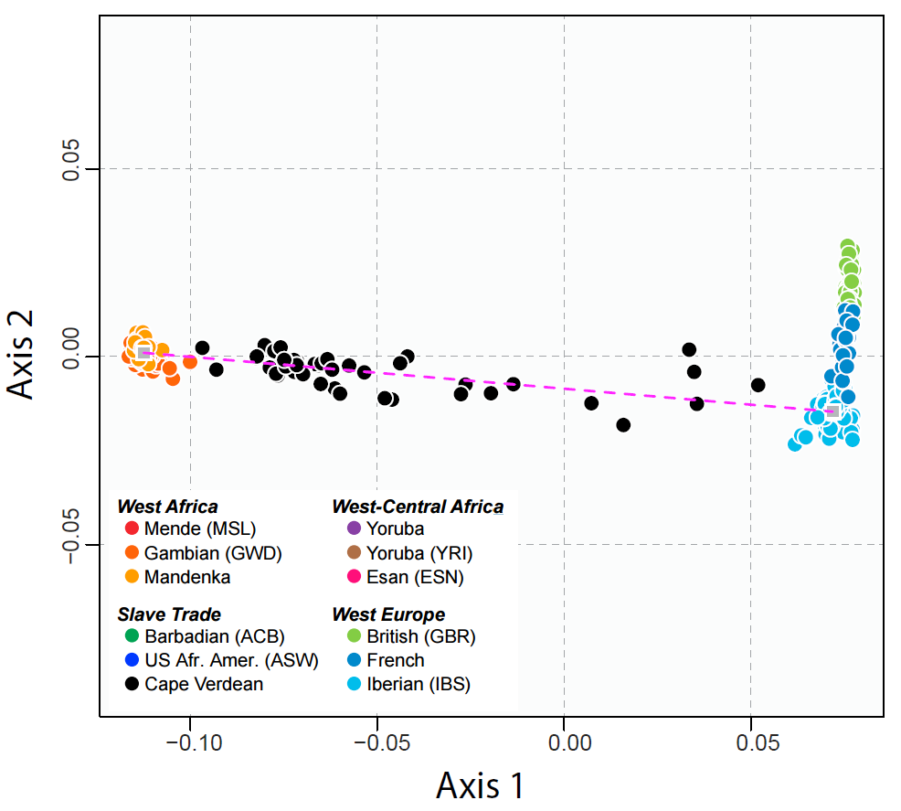
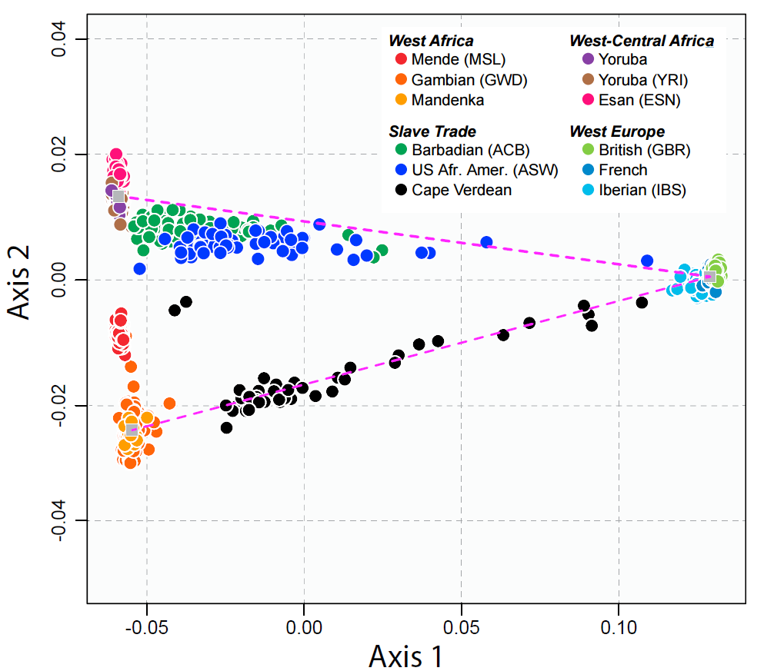
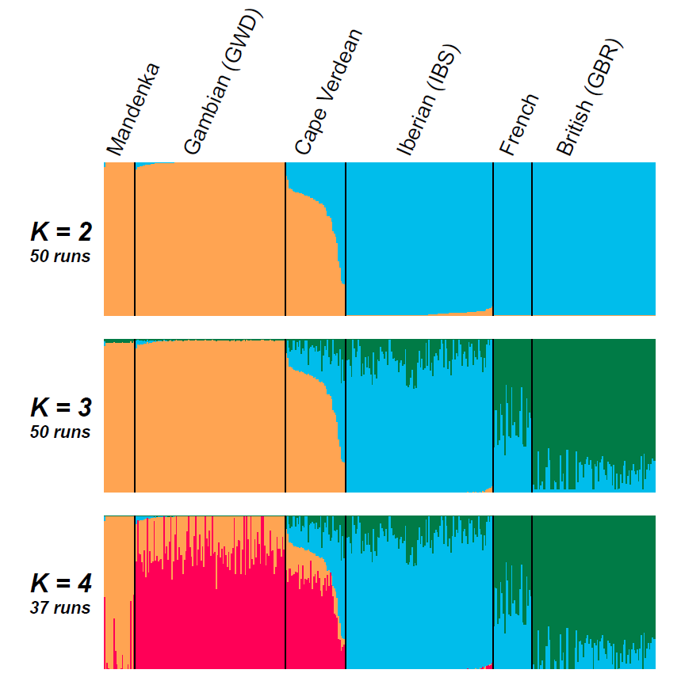
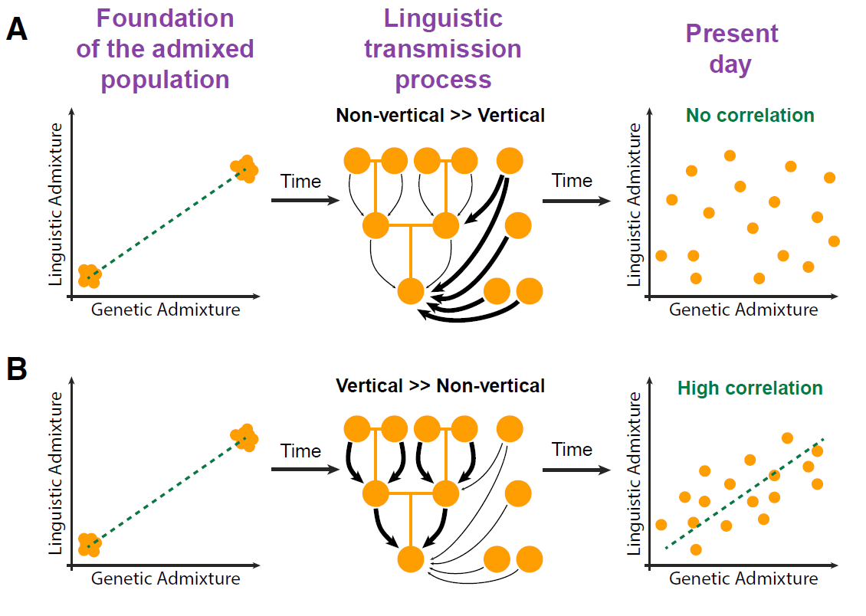
Bantu Migration | Model Analysis
Work published by Verdu et al. (2017) outlines the comparison of Creole (Cape Verdean) populations.
Methods:
2D multidimensional scaling to project the individual pairwise allele-sharing dissimilarities.
Unsupervised learning - repetitive clustering to infer admixture.
Notes:
1st MDS Plot: 2 W. African, 3 Euro, 1 Cape Verdean populations. Dotted line is the connection between the W. African and Iberian centroids.
2nd MDS Plot: 6 African, 2 W. Euro, 3 Slave-trade admixed population, Dotted line is the connection between Europeans with the West-Central African centroid and the centroid of Gambian Mandinka and Senegalese Mandenka.
Cluster Plot: Each line is an individual (399), 50 Admixture runs each (for K=2 to 4).

Slide 32
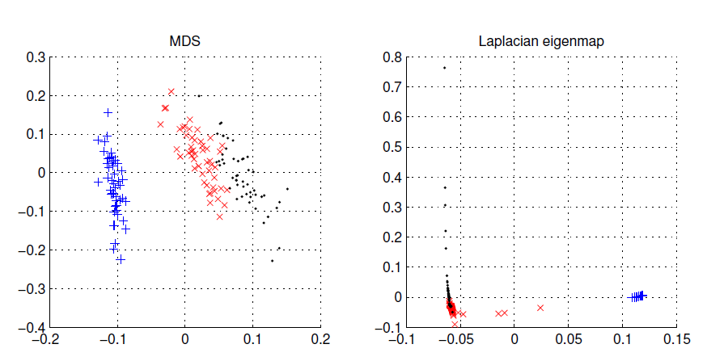
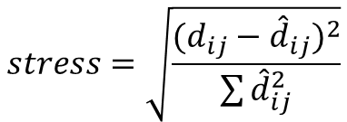
Dimensionality Reduction | MDS
Multidimensional Scaling
Input:
Correlation Matrix
Dimensionality Parameter: 2
Output:
2-dimensional coordinates
Minimize stress (≤0.05)
Cape Verdean
(Verdu, 2017)
Iris Data
(Alpaydin, 2014)
$$stress=\sqrt{\frac{{(d_{ij}−{\hat{d}}_{ij})}^{2}}{\sum{{\hat{d}}_{ij}^{2}}}}$$
Notes:
Use Feature Embedding to place in a low-dimensional map such that distances are preserved.
“PCA does the same work with MDS and does it more cheaply is d < N. PCA done on the correlation matrix rather than the covariance matrix is equivalent to doing MDS with standardized Euclidean distances where each variable has unit variance.”

Slide 33
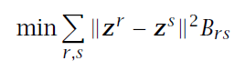
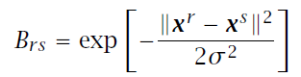
Dimensionality Reduction | LE
Let r and s be two instances and B_{rs} is their similarity, we want to find z^{r} and z^{s} that
B_{rs} can be defined in terms of similarity in an original space: 0 if x^{r} and x^{s} are too far, otherwise
Defines a graph to be Laplacian, and feature embedding returns z^{r}
Laplacian Eigenmaps
Input:
Correlation Matrix
Dimensionality Parameter: 2
Output:
2-dimensional coordinates
Uses k-NN (or ε-NN) and then Gaussian kernel to convert Euclidean distances to similarity measures.
Determine optimal k parameter by selecting the k which gives the highest accuracy.
12 (78.57% accuracy)
Iris Data
(Alpaydin, 2014)
Notes:
Part of Manifold Learning: Manifold learning is an approach to non-linear dimensionality reduction. Algorithms for this task are based on the idea that the dimensionality of many data sets is only artificially high.
Came from Spectral Graph Theory

Slide 34
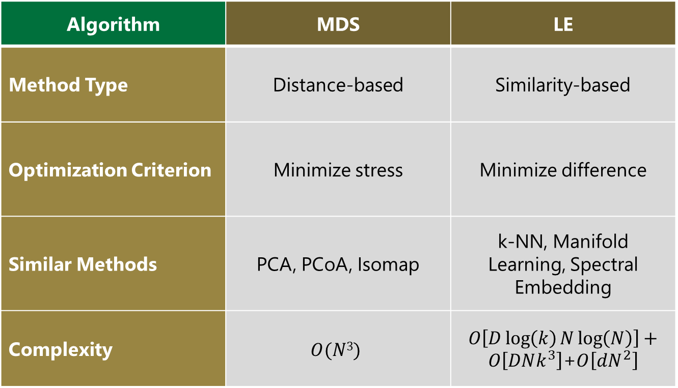
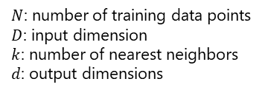
Dimensionality Reduction | Comparison
Algorithm | MDS | LE
Method Type | Distance-based | Similarity-based
Optimization Criterion | Minimize stress | Minimize difference
Similar Methods | PCA, PCoA, Isomap | k-NN, Manifold Learning, Spectral Embedding
Complexity | $$O(N3)$$ | $O\left[D\log\left(k\right)N\log\left(N\right)\right]+O\left[DNk^{3}\right]$+$O\left[dN^{2}\right]$
$N$: number of training data points
$D$: input dimension
$k$: number of nearest neighbors
$d$: output dimensions
Cayton, 2005
Belkin et al., 2003

Slide 35
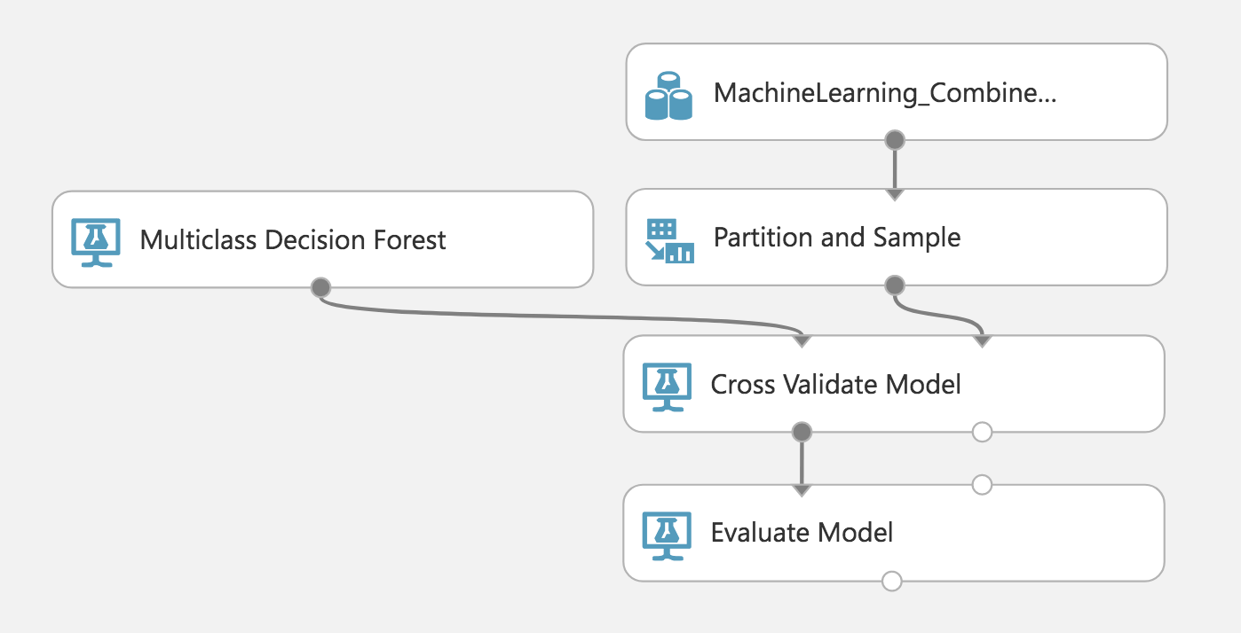
Machine Learning | Random Forest
Random Forest
Purpose:
Understand the predictive (or indicative) power of each dataset in determining the Guthrie zone of each data point.
Parameters and Input:
250 Trees
Randomized, evenly-partitioned split
Stratified by Guthrie zone
3-fold Cross-Validation
Implementation:
Microsoft Azure Machine Learning Studio
Model | Accuracy
Combined | 72.51%
Genetic (Ychr + mtDNA) | 55.22%
Ychr | 69.46%
mtDNA | 42.84%
Cultural | 52.02%
5-sample test for equality of proportions:
χ2: 6124.5, df: 4
p-value: <2.2e-16
Reject H0: “All Equal Proportions”

Slide 36




Software | Visualization and Analysis
(Tableau Software, 2017 [Link])
(Microsoft, 2016 [Link])
Microsoft® Azure
Machine Learning
(Mapbox, 2018 [Link])
(Microsoft, 2018 [Link])
(R Foundation, 2017)

Slide 37
Bantu Migration Analysis using Y-Chromosomal, Mitochondrial, and Linguistic Information
Goals:
Provide a prediction of the Bantu Migration using Paternal, Maternal, and Linguistic data.
Support or Reject claims made by previous researchers around their expansion prediction.
Use methods outlined in Verdu et al. (2017) to validate the predicted migratory pattern.
Background Information:
Researchers from linguistics have posed migratory patterns for the Bantu people.
Linguistic: Drs. Grollemund and Currie
Genetic and Linguistic: Dr. de Fillipo
There are considerable differences between these methods.
Complementary to work being completed by Dr. Jia Wen and Conor Nodzak at UNCC.

Slide 38
Final Results and Conclusion
Evidence was found that supports the “early split” hypothesis. However, there is evidence of a few subsequent migrations not seen in the previous researchers’ models.
Split at zone D (rather than around B or H).
Branching splits from zones L and M.
The combination of datasets proved to aid in generating a more robust and confident model of the Bantu migration.
Reduction in ambiguity from the singular models.
Increased accuracy from the random forest machine learning model.
Functional Hypothesis:
"Bantu expansion can be characterized by a primary split in lineages, which occurred early on and prior to the population spreading south through the now Congolese forest region.“
Technical Hypothesis:
“By combining diverse data together, a more robust migratory model can be generated that captures more of the complexity/variation in the Bantu people.”

Slide 39
Closing Remarks
Milestones:
Created individual and combined trees
Derived the apomorphies from the trees and created data structures to visualize the state transitions.
Projected migratory models geographically using the apomorphy results combined with the geographic information.
Utilized dimensionality reduction and machine learning methods for comparison/support of the combined model
Tested the early-split hypothesis of Bantu migration using these findings
Understanding human variation is a complex topic that has roots in many fields (such as biology, genomics, anthropology, and linguistics).
Only using one type of data disregards other facets of the organisms complexity.
This work has shown the importance and utility of integrating data to create a more robust model of Bantu migration.
Also, by analyzing the data using dimensionality reduction and machine learning methods, additional support has been built for the combined model.

Slide 40
Future Work
Further Bantu Research
Applicability
Although results of this work help to confirm the “early split” hypothesis, there are far more aspects of the Bantu migration that is left to be understood.
Additional work around the effects of geographical features (such as the Congolese forest or the Eastern Rift mountains) on the migratory path.
Researchers at the AMNH have been working on a similar project, but using linguistic/lexical data. (Whiteley et al., in review)
Next, this work and methodology will be combined with the AMNH linguistic research for further analysis of the migration.
As a result of this work, an end-to-end pipeline was created that allows for the combination and analysis of heterogeneous data.
This can easily be applied to other fields of research such as epidemiology (tracking infectious diseases) and in the geographical understanding of any organismal movement.
The data preparation exercises around the dimensionality reduction and machine learning analyses should prove to be useful examples for many future sequence-based evaluations.

Slide 41



Special Thanks
Committee Members
Funding and Support Sources
Dr. Daniel Janies
Carol Grotnes Belk Distinguished
Professor of Bioinformatics and Genomics
Dr. Xinghua Shi
Assistant Professor of Bioinformatics and Genomics
Dr. Anthony Fodor
Professor of Bioinformatics and Genomics
Dr. Mirsad Hadzikadic
Professor of Software and Information Systems
Dr. Matthew Parrow
Associate Professor of Biology
Wayland H. Cato Jr. Doctoral Fellowship
Tuition support and Stipend
Microsoft
Software licenses, Azure resource credits
BlueGranite, Inc.
Consultative expertise, Professional development support
Defense Applied Research Projects Agency
Contract DARPA N66001-15-C-4039 shared with
Ward Wheeler’s group at the American Museum of Natural History

Slide 42
Questions? …and Thank you!

